Slide 1
IOT,ELECTRONICS & EMBEDDED SYSTEM, PCB design, prototyping and firmware TODAY:
Presenter: ARON AYUB

Slide 2
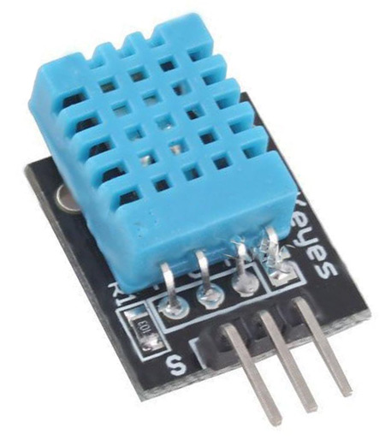
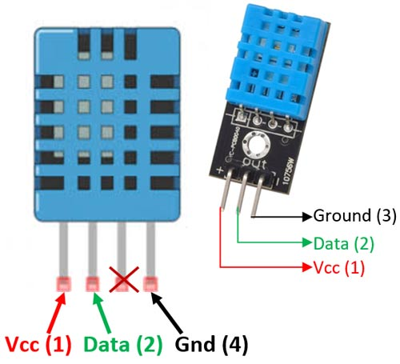
DHT SENSOR

Slide 3
How does it work?
It is a basic, ultra low-cost digital temperature and humidity sensor. I
t uses a capacitive humidity sensor
Uses a thermistor to measure the surrounding air, and spits out a digital signal on the data pin
(no analog input pins needed).

Slide 4
Components used in proteus ?
Rely
Lamp
Arduino uno
Resistor
Vsine
Connecting wire

Slide 5
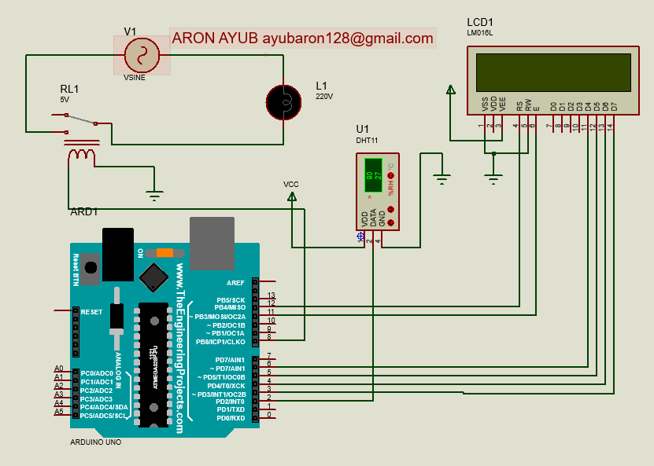
Circuit diagram

